Slide 1
Digital Portfolio
STUDENT NAME: keerthika. M
REGISTER NO AND NMID:34CBDEF48C25D688C19408EDD57EC91C
DEPARTMENT: BCA
COLLEGE: COLLEGE/ UNIVERSITY Prince sir venkateshwara arts & science college /Madras university.

Slide 2
PROJECT TITLE
DIGITAL PORTFOLIO

Slide 3


AGENDA
Problem Statement
Project Overview
End Users
Tools and Technologies
Portfolio design and Layout
Features and Functionality
Results and Screenshots
Conclusion
Github Link
3/21/2024 Annual Review

Slide 4

PROBLEM STATEMENT
In today’s competitive digital era, individuals in the IT and development fields need a professional online presence to showcase their skills, projects, and experience. Without a well-structured portfolio, it becomes difficult to highlight one’s abilities to potential recruiters, employers, or collaborators.

Slide 5
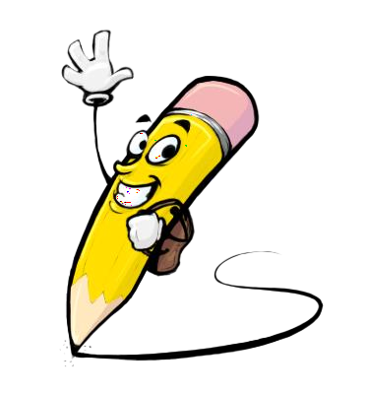
PROJECT OVERVIEW
This project is a personal portfolio website for Keerthika M, a passionate frontend web developer. The portfolio provides an interactive and professionals platform to present her skills, projects, and contact details. It aims to serve as a digital resume that is both visually appealing and user-friendly, helping her stand out in academic and career opportunities.

Slide 6

WHO ARE THE END USERS?
Recruiters and Employers – To evaluate skills and suitability for internships, jobs, or projects. Peers and Collaborators – To connect and collaborate on development projects. Educators and Mentors – To assess progress and provide guidance. General Audience – Anyone interested in frontend development portfolios.

Slide 7
POTFOLIO DESIGN AND LAYOUT
Header Section – Contains name, role, and quick action buttons (skills, GitHub, dark mode). Navigation Bar – Simple and responsive with links to About Me, Skills, and Contact. About Me Section – A short introduction about academic background and passion for frontend development. Skills Section – Displayed in a badge/tag format for quick visibility. Contact Section – Includes email, LinkedIn, and GitHub links for easy communication. Footer – Contains copyright notice.
7

Slide 8

TOOLS AND TECHNIQUES
TOOLS:
1.HTML code
2.CSS
3.JavaScript
4.Web browser.

Slide 9
FEATURES AND FUNCTIONALITY
1. Responsive Design – Works seamlessly on desktops, tablets, and mobiles. 2. Dark Mode Toggle – Enhances user experience with light/dark theme switching. 3. Skills Showcase – Displays core technical skills in categorized badges. 4. Contact Integration – Direct links to email, LinkedIn, and GitHub. 5. Easy Navigation – Smooth section-based navigation for a professional experience.

Slide 10
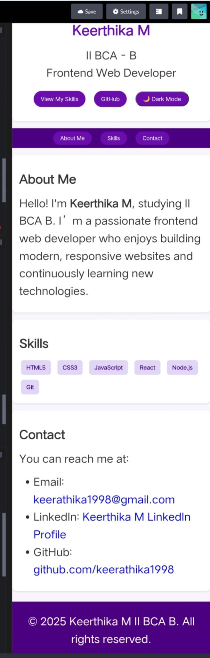

RESULTS AND SCREENSHOTS
The project resulted in a fully functional, responsive, and interactive portfolio website. It allows end users to easily learn about Keerthika’s skills, view her online profiles, and contact her for opportunities. The implementation of dark mode, modern layout, and responsive design enhances user engagement and showcases her technical expertise in real-time.
3/21/2024 Annual Review
10

Slide 11
CONCLUSION
This portfolio project successfully addresses the need for a professional digital identity. By combining modern design principles with interactive features, it effectively showcases Keerthika M’s skills and provides easy ways for recruiters and collaborators to connect. It is not just a static resume but a dynamic, engaging platform that highlights her growth as a frontend web developer.
11

Slide 12
GITHUB LINK:-
https://github.com/keerathika1998/TNSDC-FWD-DP.git

